Slide 1
Section 6 - Tableau with Kirill Eremenko
File created on: 1/19/2024 9:25:20 AM

Slide 2
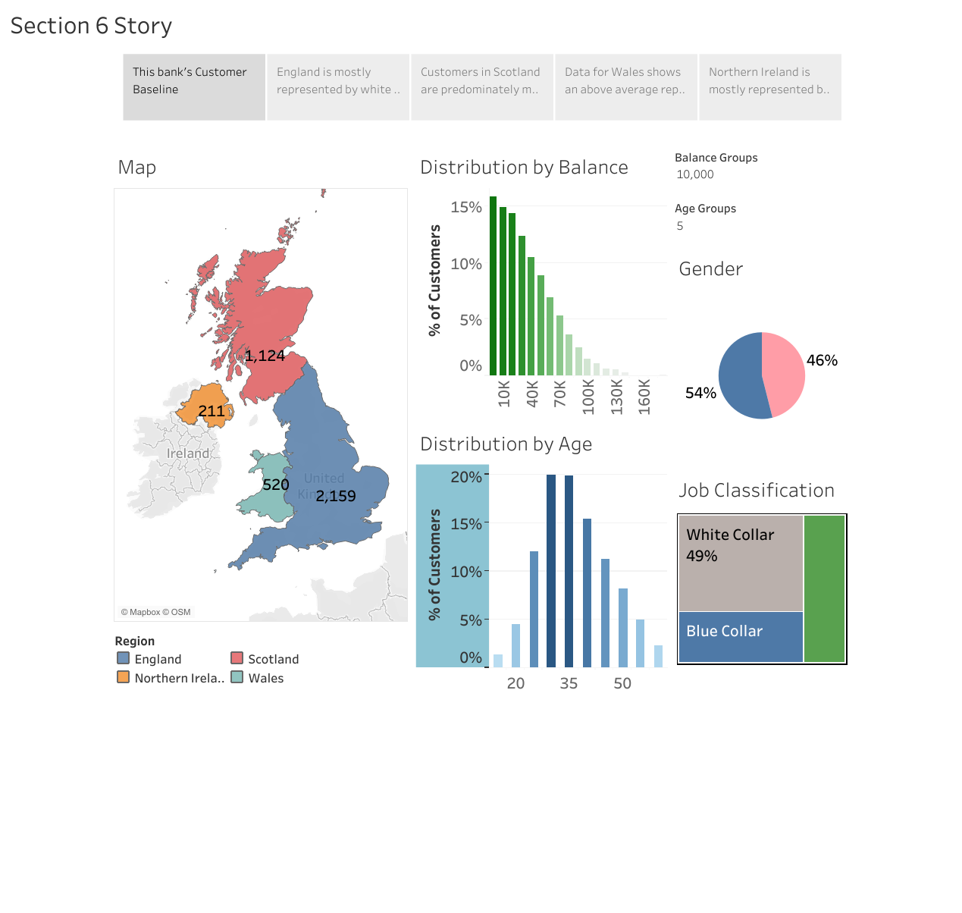

Slide 3
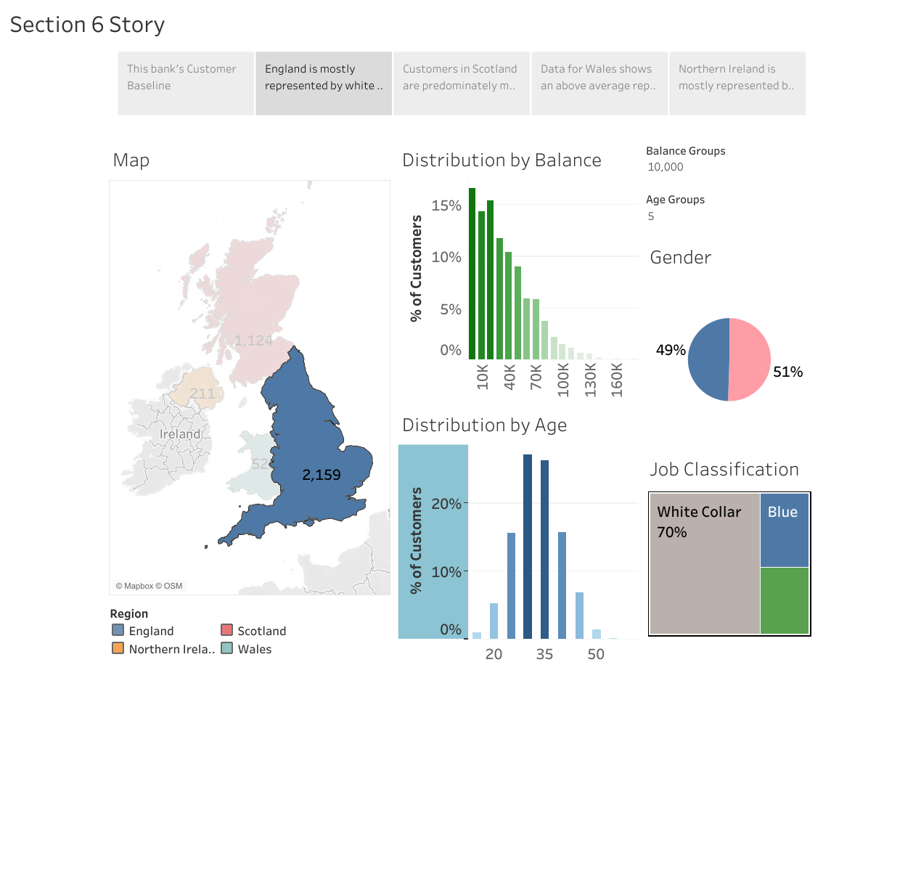

Slide 4
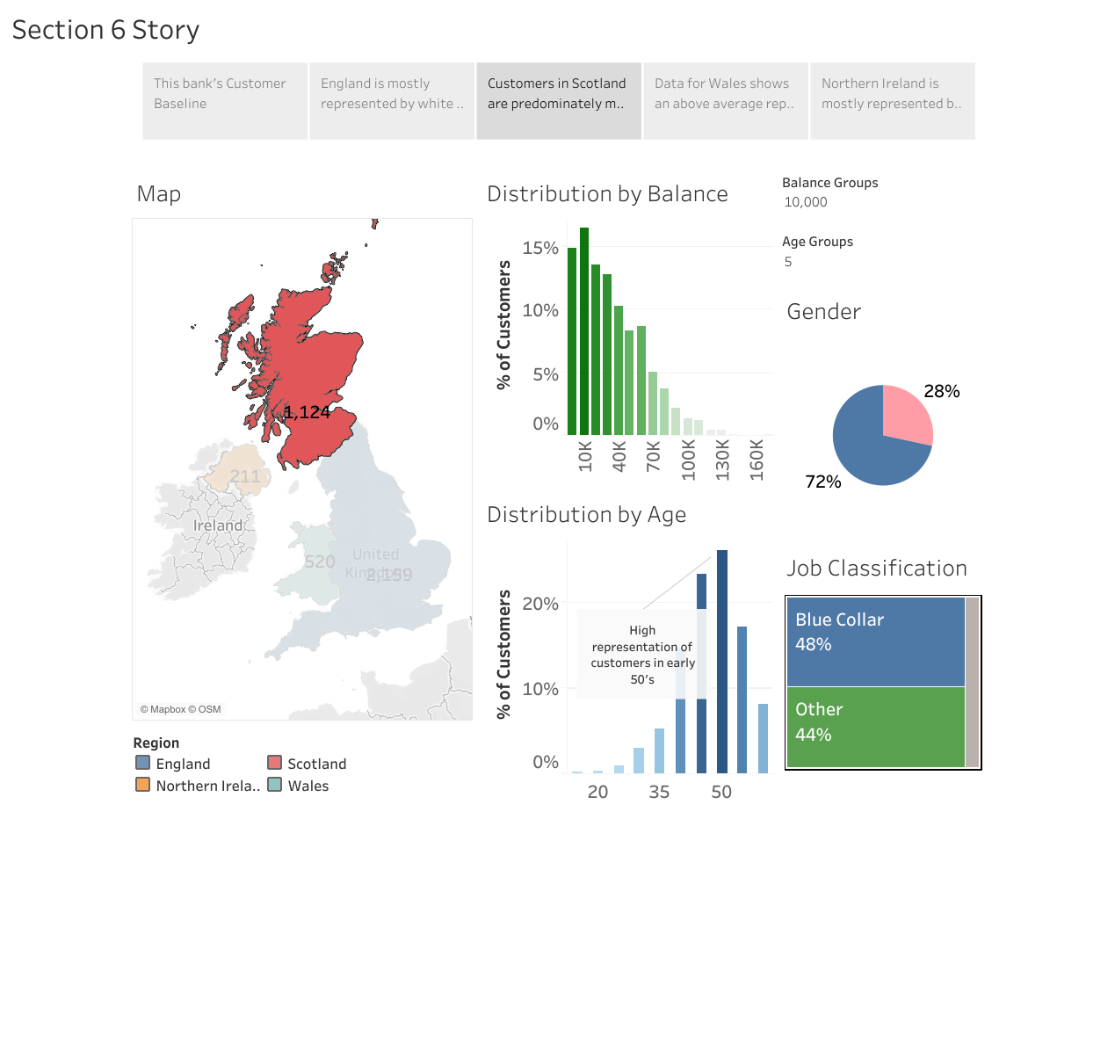

Slide 5
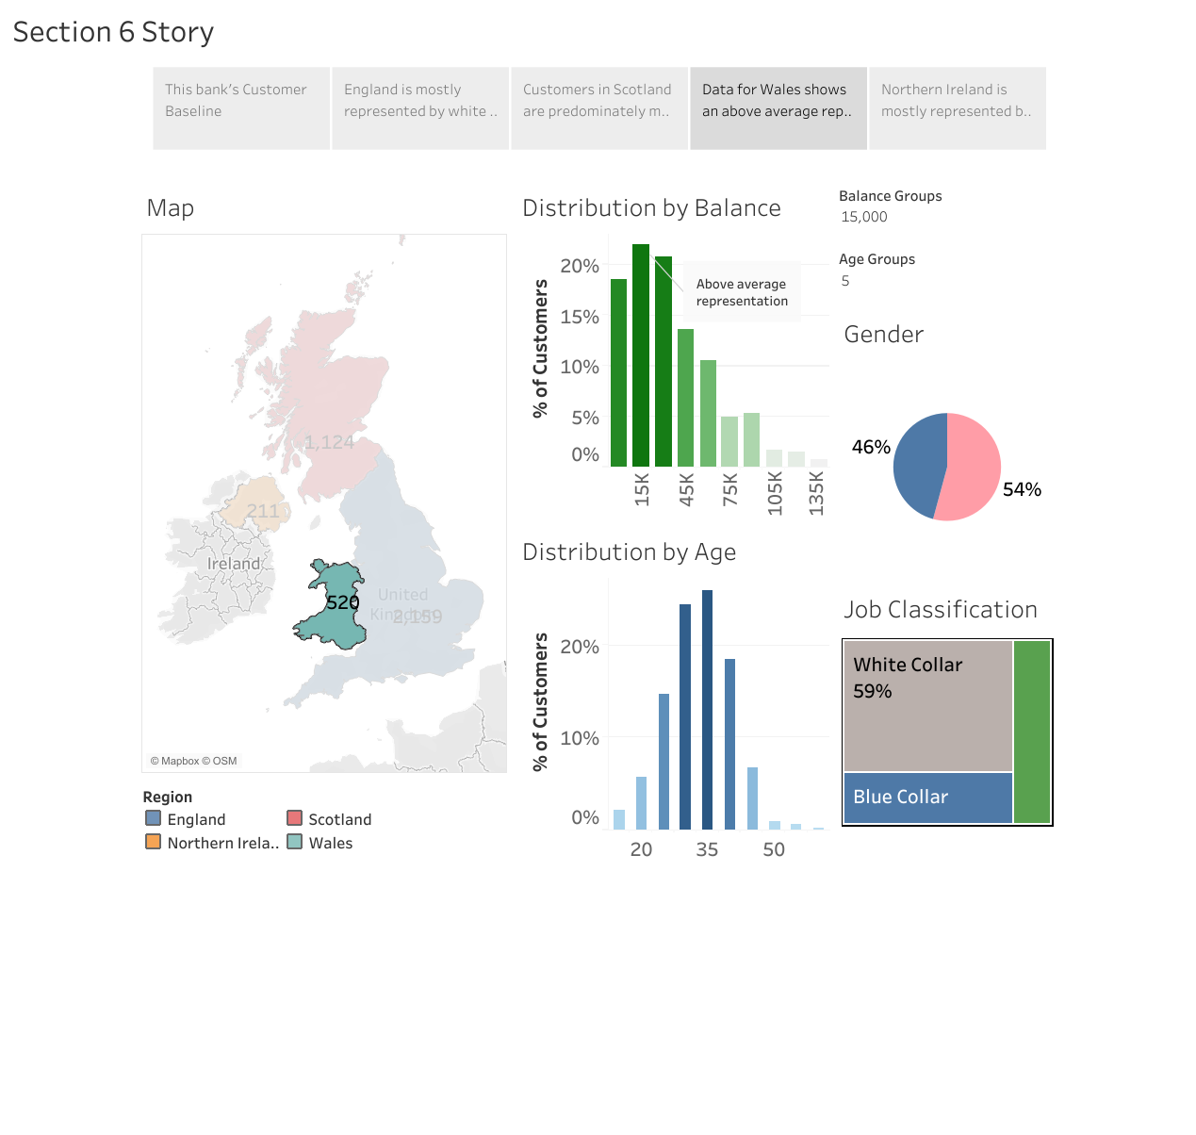

Slide 6
